Slide 1
GRADE 7 ACCELERATED · UNIT 6 · LESSON 4
Pythagorean Theorem in Real-World Problems
MA.8.GR.1.1
I can find a length in a real situation by finding the right triangle inside it.
Grade 7 Accelerated · Unit 6 · Lesson 4 — Pythagorean Theorem in Real-World Problems
1

Slide 2
Warm-Up
1. A right triangle: hypotenuse 25 ft, one leg 24 ft. The other leg?
2. Do sides of 9, 40 and 41 make a right triangle?
3. A plan's scale is 1 in : 4 ft. A wall is 3.5 in on it. Real length?
4. How many right angles does a rectangle have?
Grade 7 Accelerated · Unit 6 · Lesson 4 — Pythagorean Theorem in Real-World Problems
2

Slide 3
Warm-Up
1. A right triangle: hypotenuse 25 ft, one leg 24 ft. The other leg?
7 ft
2. Do sides of 9, 40 and 41 make a right triangle?
Yes — 81 + 1,600 = 1,681 = 41²
3. A plan's scale is 1 in : 4 ft. A wall is 3.5 in on it. Real length?
14 ft
4. How many right angles does a rectangle have?
4
Grade 7 Accelerated · Unit 6 · Lesson 4 — Pythagorean Theorem in Real-World Problems
3

Slide 4
Vocabulary
diagonal
the segment from one corner of a rectangle to the opposite corner — the hypotenuse of the right triangle it cuts off
rise and run
a ramp's height and the distance along the ground it covers; the ramp itself is the hypotenuse
Grade 7 Accelerated · Unit 6 · Lesson 4 — Pythagorean Theorem in Real-World Problems
4

Slide 5
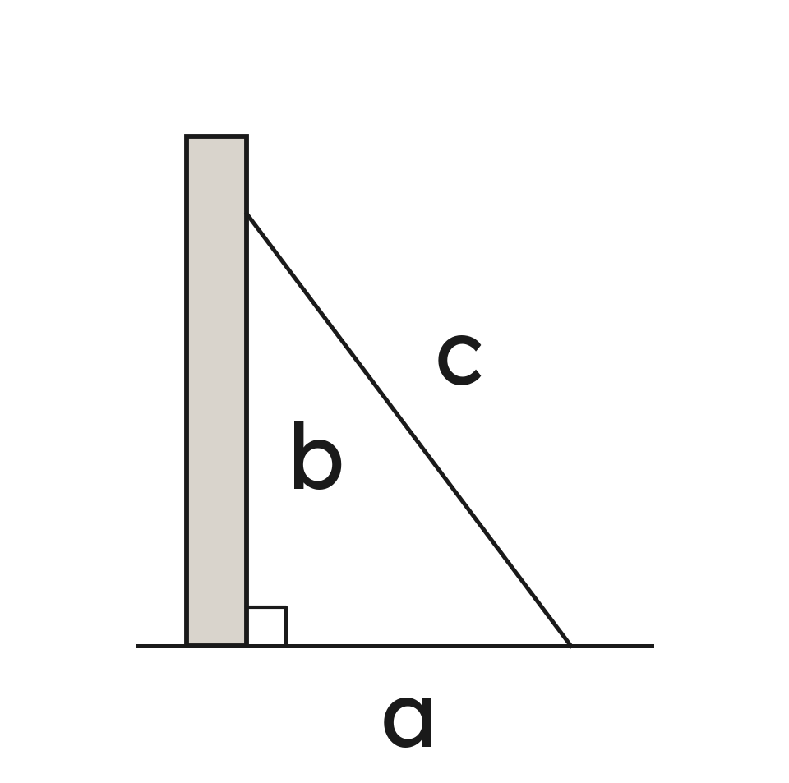
Notes
I. Find the right angle, then c
Sketch the story. Mark the right angle. The side across from it is c.
A ladder, a diagonal, a ramp, a kite string: each is the hypotenuse.
Grade 7 Accelerated · Unit 6 · Lesson 4 — Pythagorean Theorem in Real-World Problems
5

Slide 6
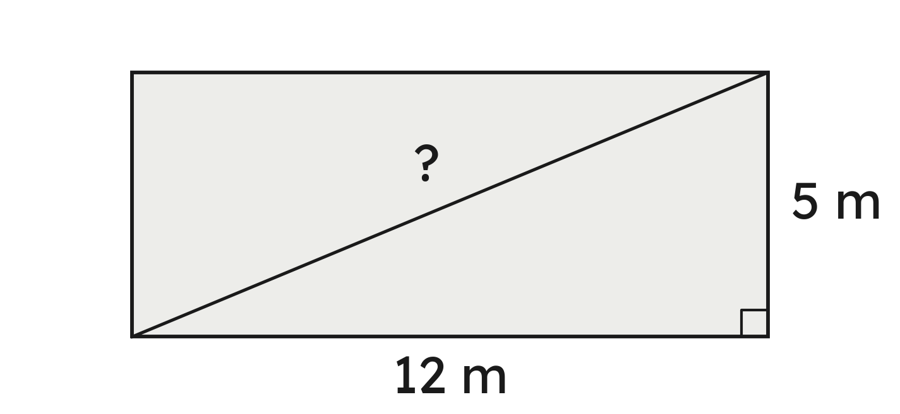
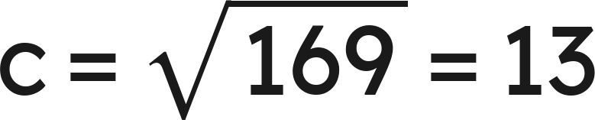
Notes
II. c in a story: the diagonal
The path is 13 m.
Grade 7 Accelerated · Unit 6 · Lesson 4 — Pythagorean Theorem in Real-World Problems
6

Slide 7
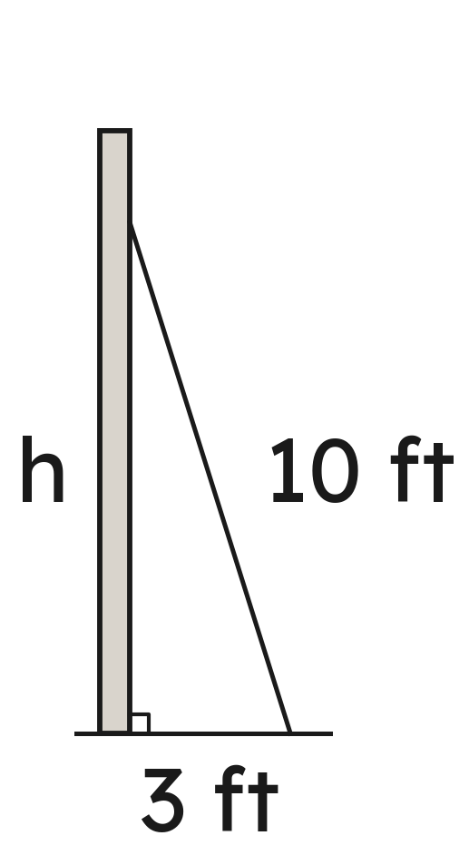
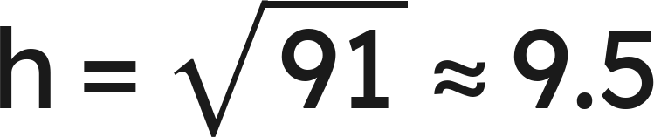
Notes
III. A leg in a story: how high
Grade 7 Accelerated · Unit 6 · Lesson 4 — Pythagorean Theorem in Real-World Problems
7

Slide 8
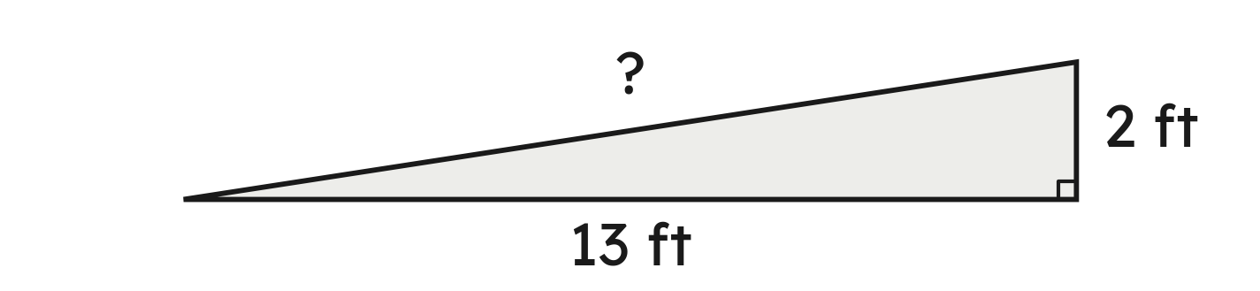
Example 1
A ramp rises 2 ft over a run of 13 ft along the ground.
How long is the ramp, to the nearest tenth of a foot?
Grade 7 Accelerated · Unit 6 · Lesson 4 — Pythagorean Theorem in Real-World Problems
8

Slide 9

Example 1
Answer: The ramp is about 13.2 ft long.
Grade 7 Accelerated · Unit 6 · Lesson 4 — Pythagorean Theorem in Real-World Problems
9

Slide 10
Your Turn
A computer screen is 7 in tall and 10 in wide.
How long is its diagonal, to the nearest tenth of an inch?
Grade 7 Accelerated · Unit 6 · Lesson 4 — Pythagorean Theorem in Real-World Problems
10

Slide 11

Your Turn
A computer screen is 7 in tall and 10 in wide.
How long is its diagonal, to the nearest tenth of an inch?
Answer: About 12.2 in
Grade 7 Accelerated · Unit 6 · Lesson 4 — Pythagorean Theorem in Real-World Problems
11

Slide 12
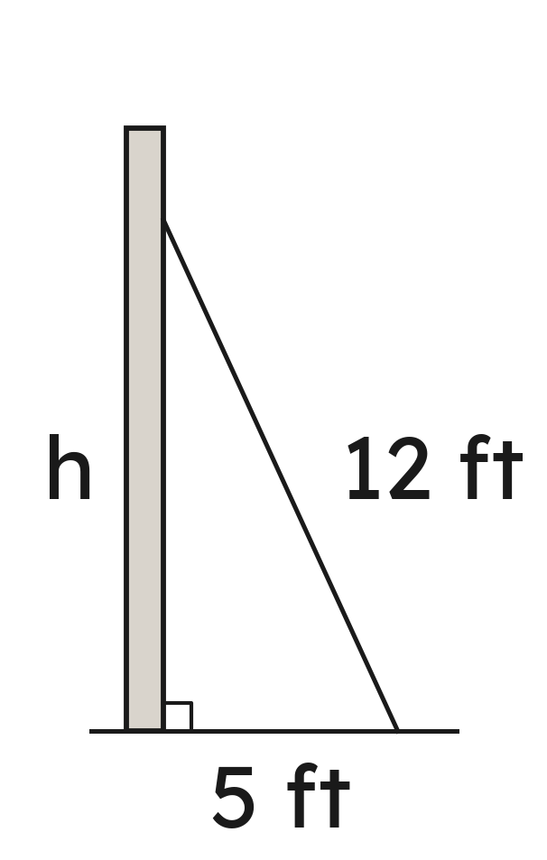
Example 2
A 12-ft ladder leans on a wall. Its foot is 5 ft from the wall.
How high up the wall does it reach, to the nearest tenth of a foot?
Grade 7 Accelerated · Unit 6 · Lesson 4 — Pythagorean Theorem in Real-World Problems
12

Slide 13
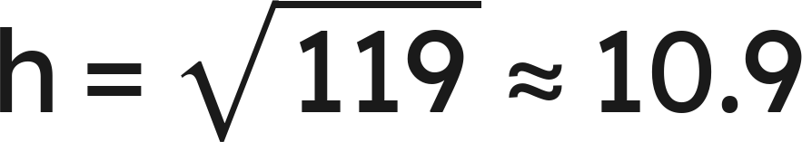
Example 2
Answer: It reaches about 10.9 ft up the wall.
Grade 7 Accelerated · Unit 6 · Lesson 4 — Pythagorean Theorem in Real-World Problems
13

Slide 14
Your Turn
A 13-ft ladder leans on a wall with its foot 6 ft from the wall.
How high does it reach, to the nearest tenth of a foot?
Grade 7 Accelerated · Unit 6 · Lesson 4 — Pythagorean Theorem in Real-World Problems
14

Slide 15

Your Turn
A 13-ft ladder leans on a wall with its foot 6 ft from the wall.
How high does it reach, to the nearest tenth of a foot?
Answer: About 11.5 ft
Grade 7 Accelerated · Unit 6 · Lesson 4 — Pythagorean Theorem in Real-World Problems
15

Slide 16
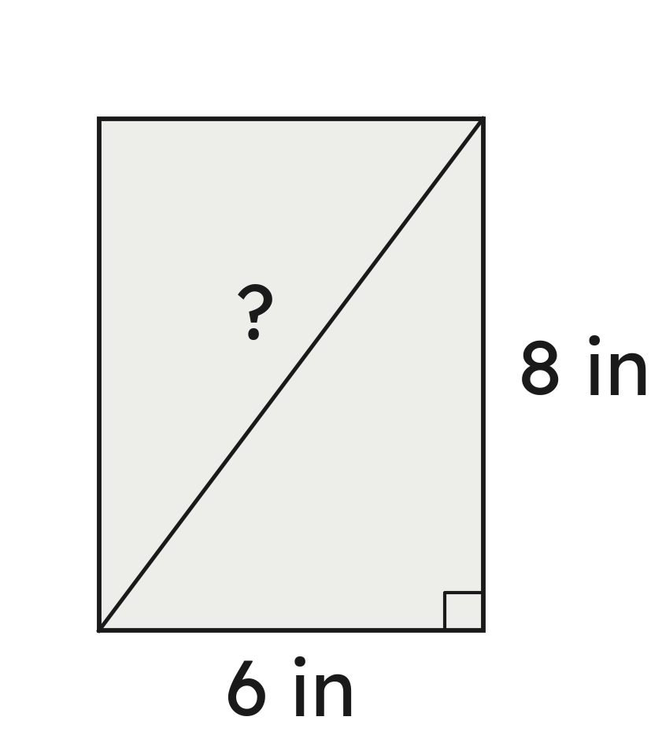
Whiteboards · Question 1 of 9
A tablet screen is 6 in wide and 8 in tall.
How long is its diagonal?
Answer it.
Grade 7 Accelerated · Unit 6 · Lesson 4 — Pythagorean Theorem in Real-World Problems
16

Slide 17


Whiteboards · Question 1 of 9
A tablet screen is 6 in wide and 8 in tall.
How long is its diagonal?
Answer: 10 in
Grade 7 Accelerated · Unit 6 · Lesson 4 — Pythagorean Theorem in Real-World Problems
17

Slide 18
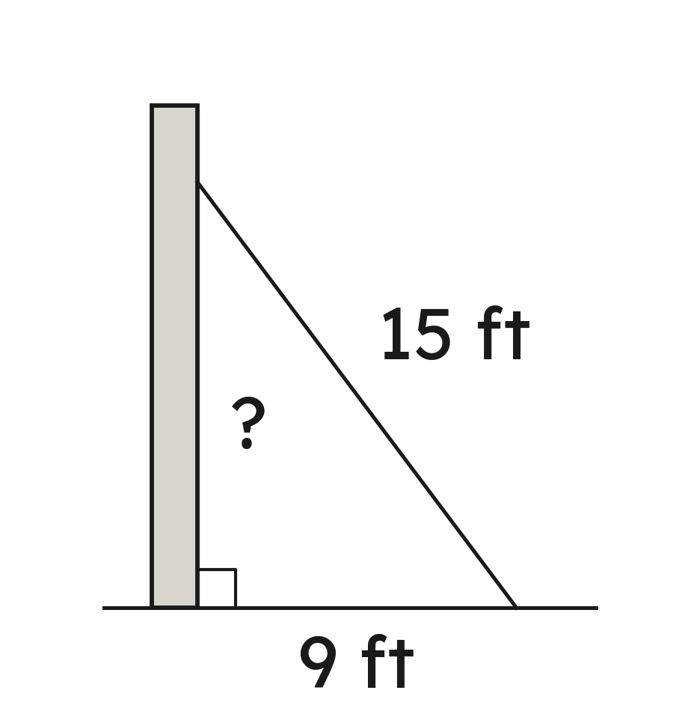
Whiteboards · Question 2 of 9
A 15-ft ladder leans on a wall. Its foot is 9 ft from the wall.
How high up the wall does it reach?
Answer it.
Grade 7 Accelerated · Unit 6 · Lesson 4 — Pythagorean Theorem in Real-World Problems
18

Slide 19

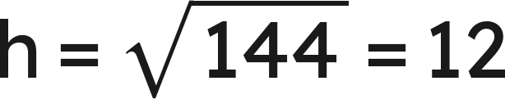
Whiteboards · Question 2 of 9
A 15-ft ladder leans on a wall. Its foot is 9 ft from the wall.
How high up the wall does it reach?
Answer: 12 ft
Grade 7 Accelerated · Unit 6 · Lesson 4 — Pythagorean Theorem in Real-World Problems
19

Slide 20

Whiteboards · Question 3 of 9
A ramp rises 1 ft over a run of 12 ft.
How long is the ramp, to the nearest tenth of a foot?
Answer it.
Grade 7 Accelerated · Unit 6 · Lesson 4 — Pythagorean Theorem in Real-World Problems
20

Slide 21


Whiteboards · Question 3 of 9
A ramp rises 1 ft over a run of 12 ft.
How long is the ramp, to the nearest tenth of a foot?
Answer: About 12.0 ft
Grade 7 Accelerated · Unit 6 · Lesson 4 — Pythagorean Theorem in Real-World Problems
21

Slide 22
Whiteboards · Question 4 of 9
A 17-ft ladder reaches 15 ft up a wall.
How far from the wall is its foot?
A. 8 ft
B. 22.7 ft
C. 2 ft
D. 64 ft
Answer it.
Grade 7 Accelerated · Unit 6 · Lesson 4 — Pythagorean Theorem in Real-World Problems
22

Slide 23

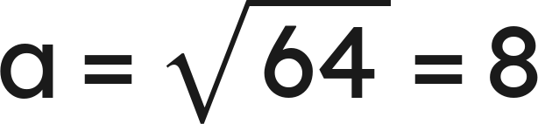
Whiteboards · Question 4 of 9
A 17-ft ladder reaches 15 ft up a wall.
How far from the wall is its foot?
Answer: A — 8 ft
Grade 7 Accelerated · Unit 6 · Lesson 4 — Pythagorean Theorem in Real-World Problems
23

Slide 24
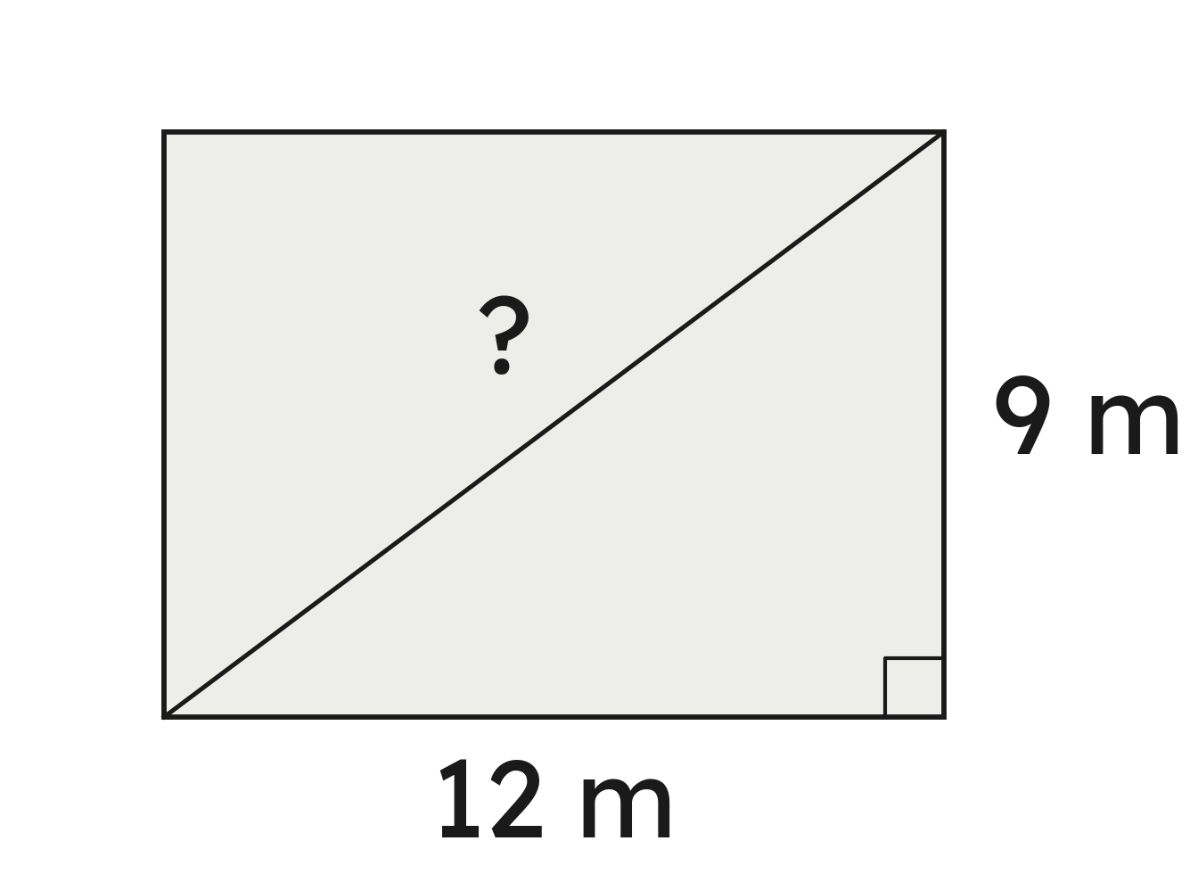
Whiteboards · Question 5 of 9
A lawn is 9 m by 12 m. Ben walks along two sides; Ava walks straight across, corner to corner.
How much shorter is Ava's walk?
Answer it.
Grade 7 Accelerated · Unit 6 · Lesson 4 — Pythagorean Theorem in Real-World Problems
24

Slide 25

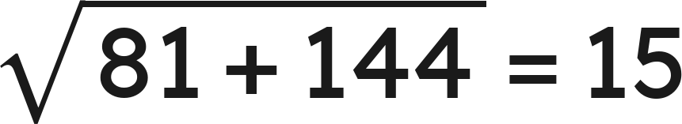

Whiteboards · Question 5 of 9
A lawn is 9 m by 12 m. Ben walks along two sides; Ava walks straight across, corner to corner.
How much shorter is Ava's walk?
Around:
Across:
Answer: 6 m shorter
Grade 7 Accelerated · Unit 6 · Lesson 4 — Pythagorean Theorem in Real-World Problems
25

Slide 26
Whiteboards · Question 6 of 9
A kite flies on 30 m of string, straight above a spot 18 m from where the string is held.
Which length is the hypotenuse?
A. the 18 m on the ground
B. the kite's height
C. the 30-m string
D. none: no right angle
Answer it.
Grade 7 Accelerated · Unit 6 · Lesson 4 — Pythagorean Theorem in Real-World Problems
26

Slide 27
Whiteboards · Question 6 of 9
A kite flies on 30 m of string, straight above a spot 18 m from where the string is held.
Which length is the hypotenuse?
The square corner is under the kite.
Across from it: the string.
Answer: C — the 30-m string
Grade 7 Accelerated · Unit 6 · Lesson 4 — Pythagorean Theorem in Real-World Problems
27

Slide 28
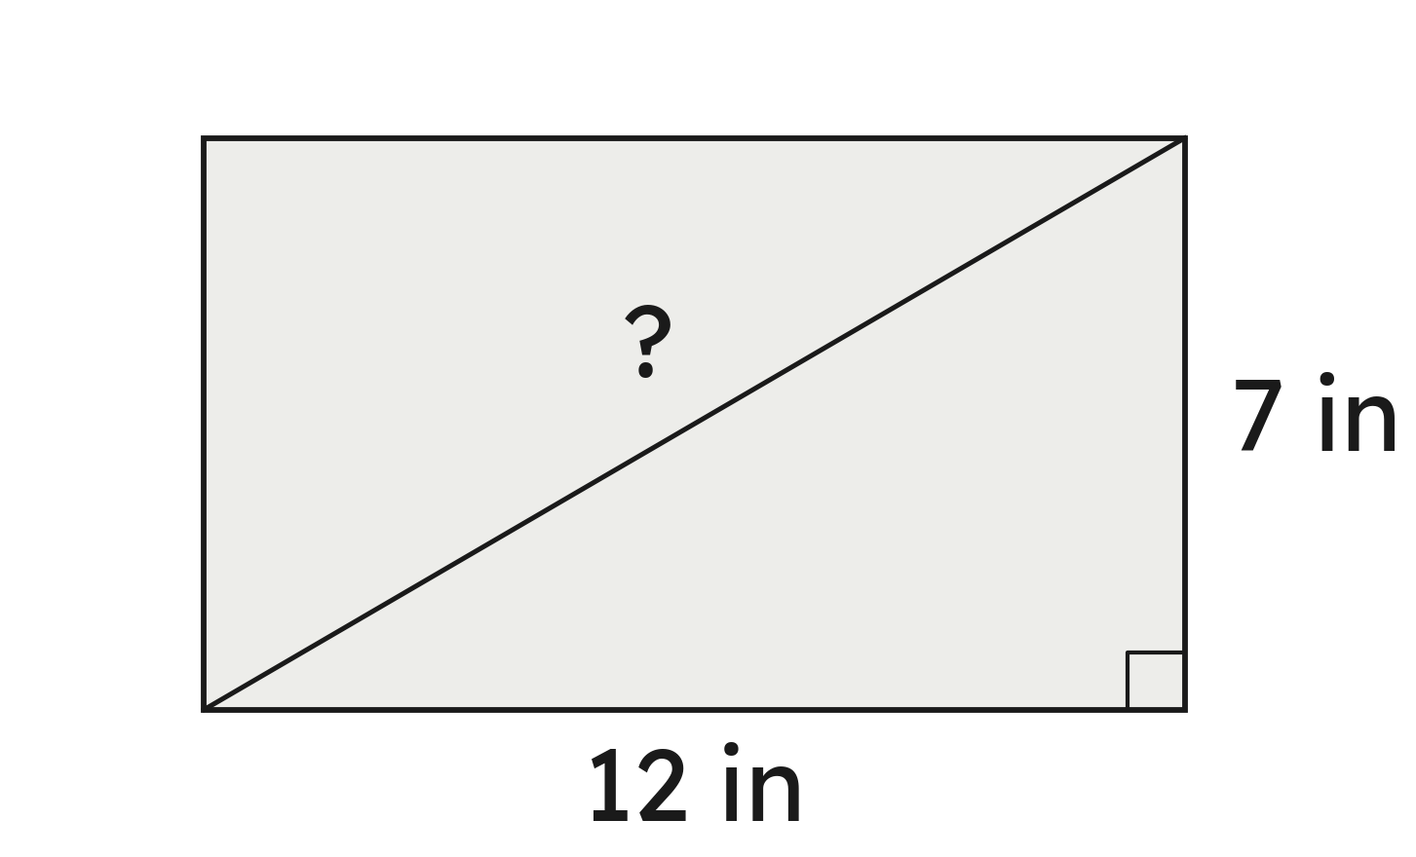
Whiteboards · Question 7 of 9
A box is 7 in wide and 12 in long.
Will a 14-in umbrella lie flat in it, corner to corner?
Answer it.
Grade 7 Accelerated · Unit 6 · Lesson 4 — Pythagorean Theorem in Real-World Problems
28

Slide 29


Whiteboards · Question 7 of 9
A box is 7 in wide and 12 in long.
Will a 14-in umbrella lie flat in it, corner to corner?
Answer: No — the diagonal is about 13.9 in.
Grade 7 Accelerated · Unit 6 · Lesson 4 — Pythagorean Theorem in Real-World Problems
29

Slide 30
Whiteboards · Question 8 of 9
A 10-ft ladder that weighs 25 pounds has its foot 7 ft from a wall.
How high does it reach, to the nearest tenth of a foot?
Answer it.
Grade 7 Accelerated · Unit 6 · Lesson 4 — Pythagorean Theorem in Real-World Problems
30

Slide 31


Whiteboards · Question 8 of 9
A 10-ft ladder that weighs 25 pounds has its foot 7 ft from a wall.
How high does it reach, to the nearest tenth of a foot?
Answer: About 7.1 ft
Grade 7 Accelerated · Unit 6 · Lesson 4 — Pythagorean Theorem in Real-World Problems
31

Slide 32
Whiteboards · Question 9 of 9
A window is 12 ft above the ground.
Why can an 11-ft ladder never reach it, wherever its foot stands?
Write your answer in sentences.
Grade 7 Accelerated · Unit 6 · Lesson 4 — Pythagorean Theorem in Real-World Problems
32

Slide 33
Whiteboards · Question 9 of 9
A window is 12 ft above the ground.
Why can an 11-ft ladder never reach it, wherever its foot stands?
The ladder is the hypotenuse, the longest side.
The height is a leg, so it is less than 11 ft.
Answer: The height is a leg — always shorter than the 11-ft ladder.
Grade 7 Accelerated · Unit 6 · Lesson 4 — Pythagorean Theorem in Real-World Problems
33

Slide 34
Independent Set
1.
A tablet screen is 5 in wide and 8 in tall. How long is its diagonal, to the nearest tenth of an inch?
2.
A 26-ft ladder reaches 24 ft up a wall. How far from the wall is its foot?
3.
A ramp rises 3 ft over a run of 14 ft. How long is the ramp, to the nearest tenth of a foot?
4.
A park is 7 m by 11 m. How much shorter is the walk straight across, corner to corner, than the walk along two sides? Give it to the nearest tenth of a meter.
5.
Will a 10-in pencil lie flat in a box 7 in by 8 in, corner to corner?
6.
A kite flies at the end of 25 m of string, straight above a spot 20 m from where the string is held. How high is the kite?
Grade 7 Accelerated · Unit 6 · Lesson 4 — Pythagorean Theorem in Real-World Problems
34

Slide 35
IXL
1.
Open IXL and start today's skills.
2.
Work on paper where the question needs work. The answer box does not show it.
3.
Every skill listed is required, to a SmartScore of 67. Due at the start of the next class.
Today's skills — all required
Pythagorean theorem: word problems — 87U
Grade 7 Accelerated · Unit 6 · Lesson 4 — Pythagorean Theorem in Real-World Problems
35

